Slide 1



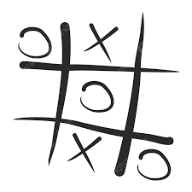
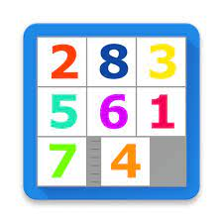
Cover Page
AI Project
N-Puzzel

Slide 2
Team Members :
Name | ID
يارا عماد درويش يوسف | 20211040
احمد عبد النبي عبد المعطي عبد العزيز | 20210076
ولاء اسامه عبدالقادر مصطفي | 20211039
هادي محمد عبدالهادي | 20211028
زينب عماد محمود ابراهيم | 20210386
احمد عبدالرحمن محمد عبدالرحمن | 20210070
مريم ربيع دياب السيد | 202000877

Slide 3
Project idea and overview
An Intelligent N-Puzzle Solver (for sizes: 8, 15, and 24) using a Best-First Search
algorithm (designing & implementing at least 4 heuristic functions).
The 15-puzzle (also called Game of Fifteen, Mystic Square and many others) is a sliding puzzle that consists of a frame of numbered square tiles in random order with one tile missing. The puzzle also exists in other sizes , particularly the smaller 8-puzzle. If the size is 3×3 tiles, the puzzle is called the 8-puzzle or 9-puzzle, and if 4×4 tiles, the puzzle is called the 15-puzzle or 16-puzzle named, respectively, for the number of tiles and the number of spaces. The object of the puzzle is to place the tiles in order by making sliding moves that use the empty space . The n-puzzle is a classical problem for modelling algorithms involving heuristics. Commonly used heuristics for this problem include counting the number of misplaced tiles and finding the sum of the taxicab-distances between each block and its position in the goal configuration.
Similar Project
https://igorgarbuz.github.io/n-puzzle/

Slide 4
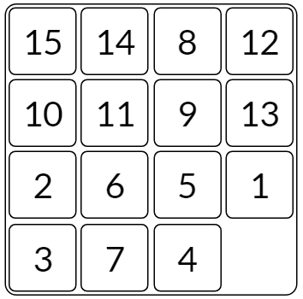
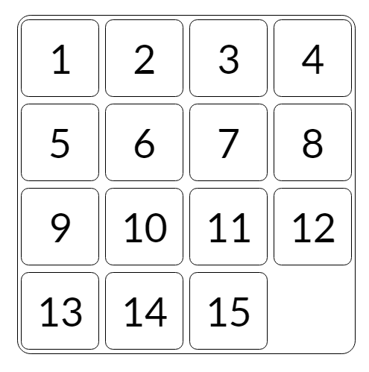
What is the N-Puzzel?
The puzzle exists in various sizes, such as the smaller 3x3 "8 Puzzle" and the larger 5x5 "24 Puzzle". In general, these sliding puzzles are collectively called the "n-puzzle" (also called the "(n^2-1)-puzzle")placed on a grid square , with one tile empty. The goal of the puzzle is to slide the tiles around to reach the solved state
As Ex. 15 Puzzle
Initial state
Goal state

Slide 5
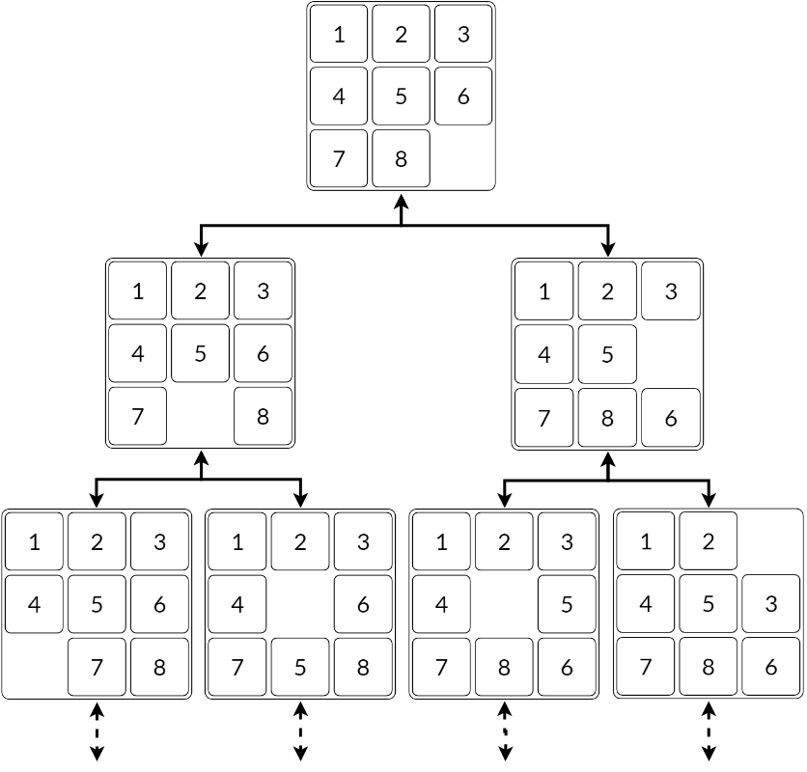
Optimal Solutions
Each state of the board can be represented as a node in a graph, and two nodes are connected with an edge if one of the board states can be turned into the other by sliding a tile
Finding the optimal solution to a board is equivalent to finding the shortest path from the current board state to the solved board state. A common path finding algorithm is A*, which traverses through the search space using a heuristic which estimates the distance to the desired end state. While A* would work for solving the 15 Puzzle, its memory usage increases exponentially with the length of the solution. This is reasonable for the 8 Puzzle, as the hardest boards take

Slide 6
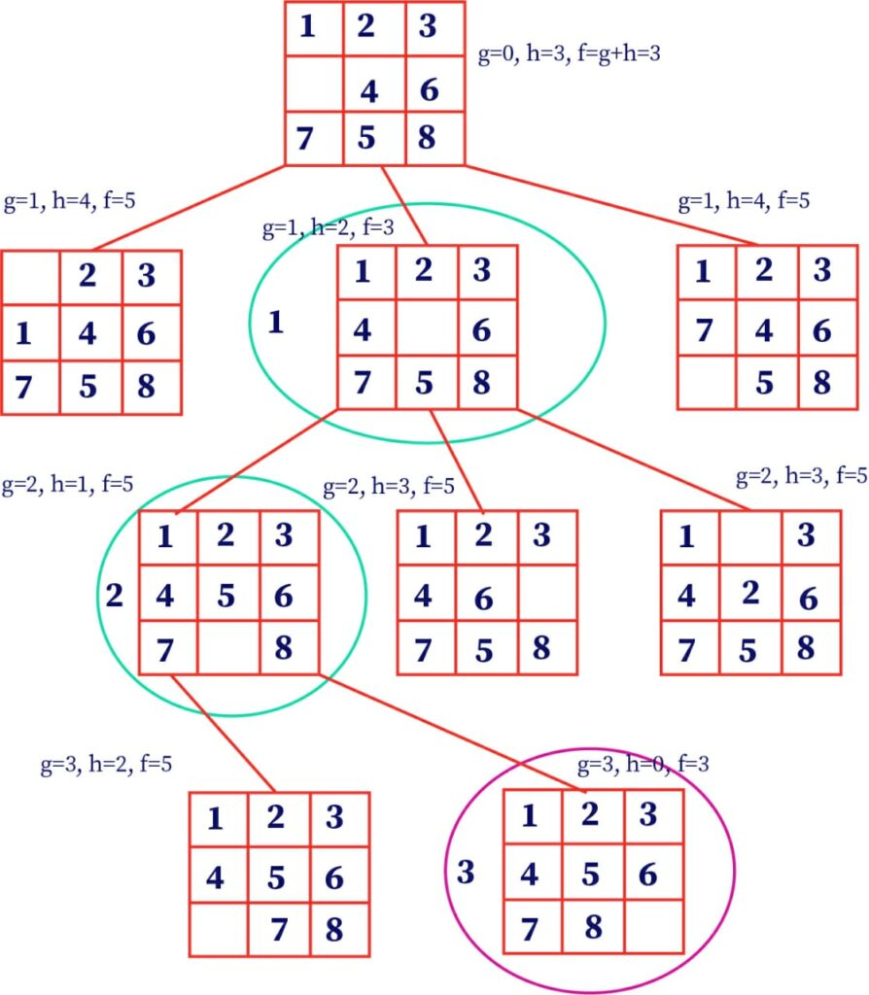
Heuristic functions
1. Misplaced Tiles
The simplest heuristic for the n Puzzle is to count the number of misplaced tiles. However, it performs horribly as the heuristic doesn't provide any information about how those tiles are misplaced, such as how far a misplaced tile is from being correct.

Slide 7
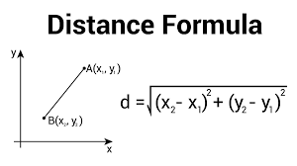
Heuristic functions
2. Euclidean Distance
The heuristic that we are going to study is going to be very similar to the distance of Manhattan, because I am going to calculate the amount of distances in diagonal from the position in the final state regarding the current position of the boxes. This heuristic is going to be very good as the distance of Manhattan, because we are going to take into account a distance to the final position, although the distance will be less real than the first heuristic, since it is not going to be able to move in diagonal by the puzzle. This heuristic is going to be admissible, since it is going to be always lower the distance in a straight line, than the steps that we will have to do to reach the final solution
The way to calculate this is like the Pythagorean Theorem, we have to calculate the rest of the coordinates (of the end state to the current), powering to the square separately, add each of these and apply the operator square root. This with each box and then join all the boxes except the blank

Slide 8
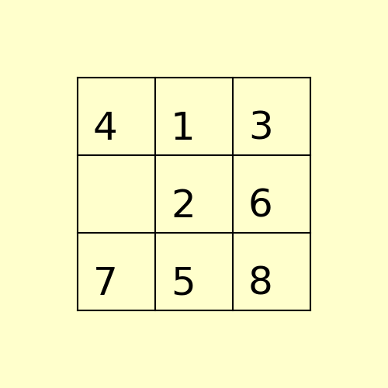
Heuristic functions
3. Manhattan Distance (MD)
This is effectively a lower bound on the minimum moves needed for each tile to reach its solved position. MD performs better than the previous heuristic, and is enough to solve all 8 Puzzle instances in a reasonable amount of time.
The main issue with Manhattan distance is that it doesn't take into account the interactions between tiles. It assumes each tile can move independently from the other tiles, resulting in a very low bound on the actual cost

Slide 9
Heuristic functions
4. Permutation Inversion
This heuristic builds upon linear conflicts and uses the idea of inversions.
Consider unraveling the square into a single row of tiles (left-to-right, top-to-bottom):
We define an inversion to be when a tile appears before another tile with a smaller number. The blank has no number and cannot contribute to inversions. There are a few things to note about inversions
We can do the same for horizontal moves. However, the ordering is now top-to-bottom, left-to-right:

Slide 10
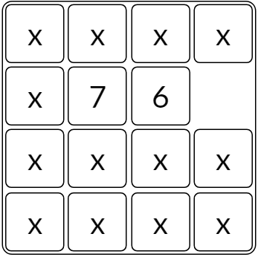
Heuristic functions
5. Linear Conflict
Consider two tiles that are in the same row or column, and their goals are also in the same row or column, but they're in the wrong order. According to the Manhattan distance heuristic, both misplaced tiles are 1 tile away from their end position. However, it's impossible to swap the two tiles in just 2 moves. In fact, at least 2 additional moves are needed to move one out of the way for the other one to move into its place.
The linear conflict heuristic adds 2 moves for every linear conflict in the board. This can be used in addition to the Manhattan distance by summing the two heuristics together.

Slide 11
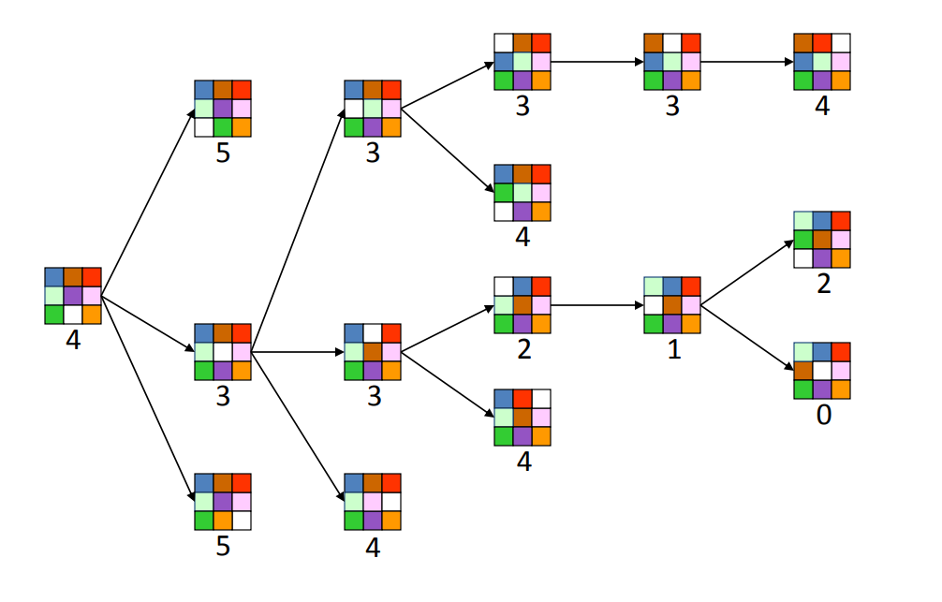
Applied Algorithms
Best-First Search algorithm
We define a state of the game to be the board position, the number of moves made to reach the board position, and the previous state. First, insert the initial state (the initial board, 0 moves, and a null previous state) into a priority queue. Then, delete from the priority queue the state with the minimum priority, and insert onto the priority queue all neighboring states (those that can be reached in one move). Repeat this procedure until the state dequeued is the goal state. The success of this approach hinges on the choice of priority function for a state.

Slide 12
Main functionalities features
User Interface (UI):
Creation of a graphical user interface (GUI) allowing users to interact with the puzzle.
Heuristic Functions:
Implementation of heuristic functions (like Hamming, Manhattan, Euclidean) to estimate the cost of reaching the goal state from a given puzzle configuration.
Search Algorithms:
Implementation of search algorithms (Best-first search)to solve the puzzle by traversing through the puzzle states and finding the optimal solution.
Solution Validation:
Validation of the obtained solution to ensure it meets the puzzle requirements.
Checking if the final state matches the goal state and whether it is a valid solution.
Performance Metrics:
Calculation and display of metrics like number of moves, nodes expanded, or path cost to solve the puzzle.
Configuration Options:
Offering settings or options to configure different aspects of the puzzle-solving process, such as selecting different puzzle sizes, algorithms, or heuristic functions.
User Interaction:
Enabling user interactions like resetting the puzzle, randomizing the puzzle, step-by-step solution visualization, or allowing manual moves(playing).

Slide 13
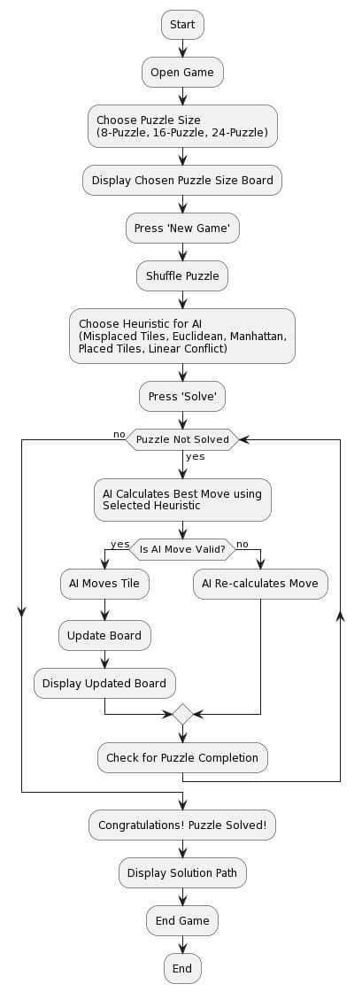
Flowcharts Diagram

Slide 14
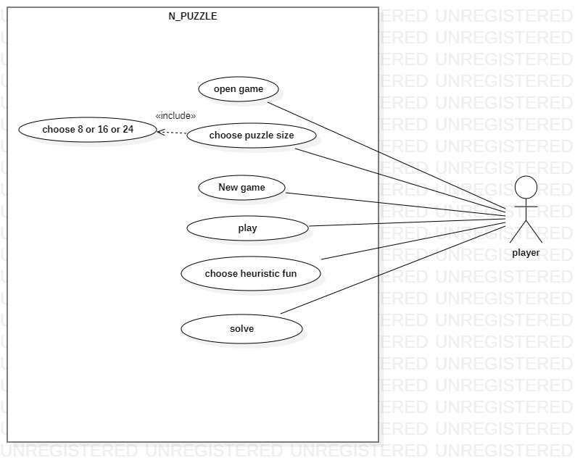
UseCase Diagram

Slide 15
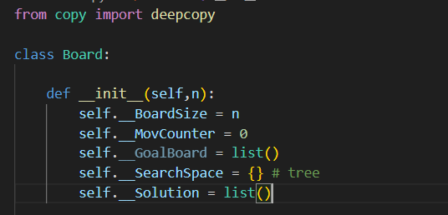
Board code
Certainly! The Board class manages various aspects of an N-Puzzle problem, particularly in finding the solution path from the initial state to the goal state. Let's delve deeper into the purpose and functionality of some key methods.
Initializes the Board instance with necessary attributes:
self.__BoardSize: Represents the size of the board.
self.__MovCounter: Tracks the number of movements made.
self.__GoalBoard: Represents the goal configuration of the board.
self.__SearchSpace: Represents the search space as a dictionary/tree.
self.__Solution: Stores the solution path.

Slide 16
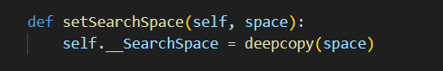
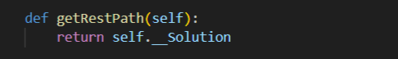
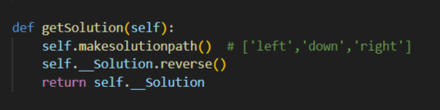
Board code
Sets the search space with a deepcopy of the provided space.
Returns the remaining path in the solution
Constructs and retrieves the solution path by calling makesolutionpath().
Reverses the solution path to obtain the correct sequence.
Returns the solution.

Slide 17
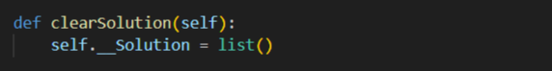
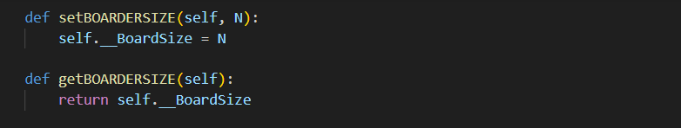
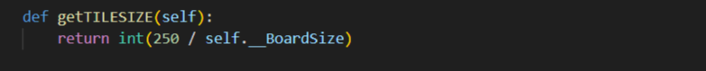
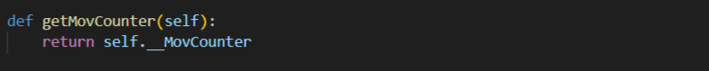
Board code
Clears the solution path.
Sets the board size.
Retrieves the board size.
Calculates and returns the tile size based on the board size.
Retrieves the movement counter.
.

Slide 18
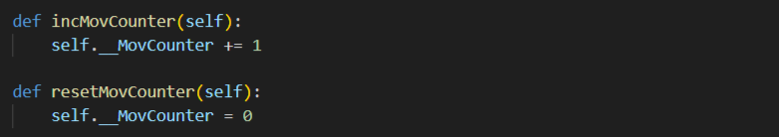
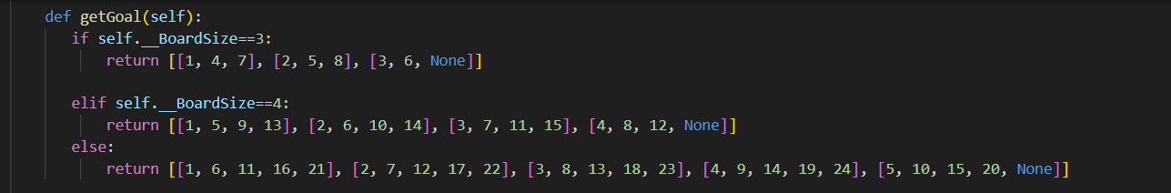
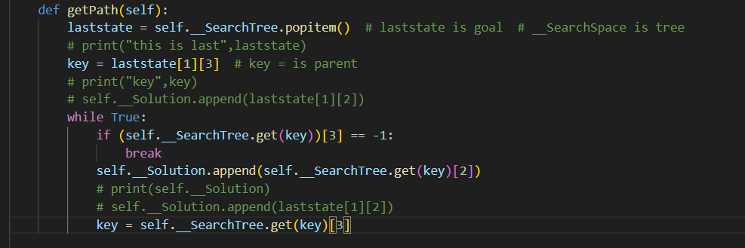
Board code
Increments the movement counter.
Resets the movement counter.
Returns the goal board configuration based on the board size.
Constructs the solution path by backtracking through the search space.
Retrieves the last state (goal state) from the search space.
Traverses through the search space to find the solution path by following parent keys until reaching the initial state.

Slide 19
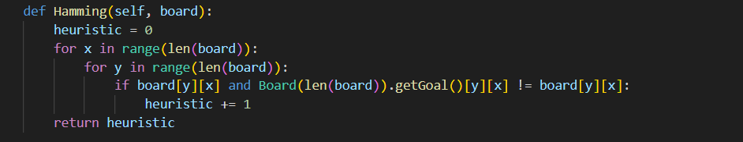
Heuristic code
containing several heuristic functions used for solving the N-Puzzle problem
Hamming(self, board)
Calculates the Hamming distance heuristic for the given board configuration.
Hamming distance measures the number of misplaced tiles compared to the goal state.
Iterates through the board and increments the heuristic value for each misplaced tile.

Slide 20
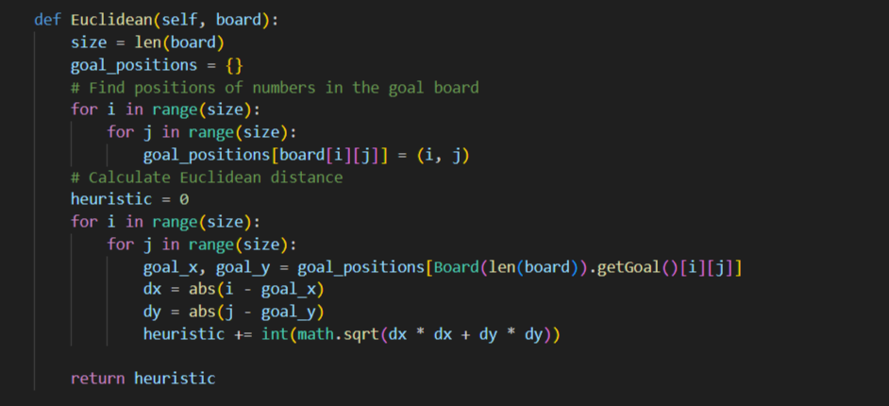
Heuristic code
Euclidean(self, board)
Calculates the Euclidean distance heuristic for the given board configuration.
Computes the Euclidean distance for each tile between its current position and its goal position.
Utilizes a dictionary goal_positions to store the positions of numbers in the goal board.
Iterates through the board, retrieves goal positions, and calculates the Euclidean distance for each tile.

Slide 21
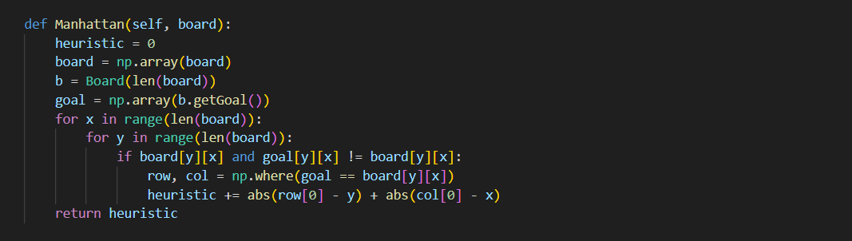
Heuristic code
Manhattan(self, board)
Calculates the Manhattan distance heuristic for the given board configuration.
Manhattan distance measures the total number of moves required for each tile to reach its goal position horizontally and vertically.
Utilizes NumPy arrays to work with matrices efficiently.
Computes the distance for each tile between its current position and its goal position, accumulating the distances in the heuristic value.

Slide 22
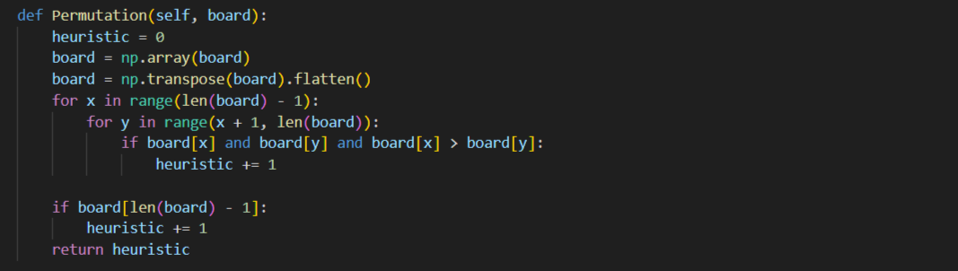
Heuristic code
Permutation(self, board)
Computes the permutation inversion heuristic for the given board configuration.
Determines the number of tile inversions to reach the goal state.
Transposes the board to a 1D array and counts the inversions between tiles.

Slide 23
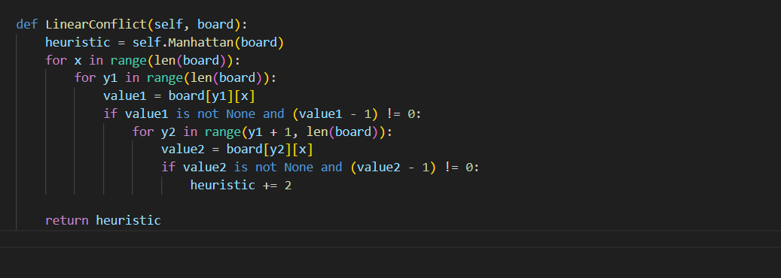
Heuristic code
LinearConflict(self, board)
Enhances the Manhattan distance heuristic by considering linear conflicts between tiles.
A linear conflict occurs when two tiles that belong to the same line have to cross each other's path to reach their goal positions.
Calculates the Manhattan distance and considers additional conflicts between tiles in the same row or column, incrementing the heuristic value accordingly.
These heuristic functions are employed in solving the N-Puzzle problem, providing different estimates of how far the current state is from the goal state. They are commonly used in informed search algorithms like A* to guide the search towards the solution.

Slide 24
GUI code
This class manages the graphical user interface (GUI) of the N-Puzzle game.
Initializes various attributes, constants, and settings required for the game.
Defines methods for handling user input, drawing the game board, generating new puzzles, and solving the puzzle using different heuristics.

Slide 25
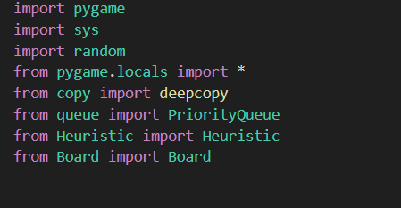
GUI code
Libraries Used:
pygame: Used for creating the game's graphical interface.
sys, random: Standard Python libraries for system-specific functions and generating random numbers.
copy.deepcopy: Used for creating a deep copy of objects.
queue.PriorityQueue: A queue implementation where each element has a priority associated with it.

Slide 26
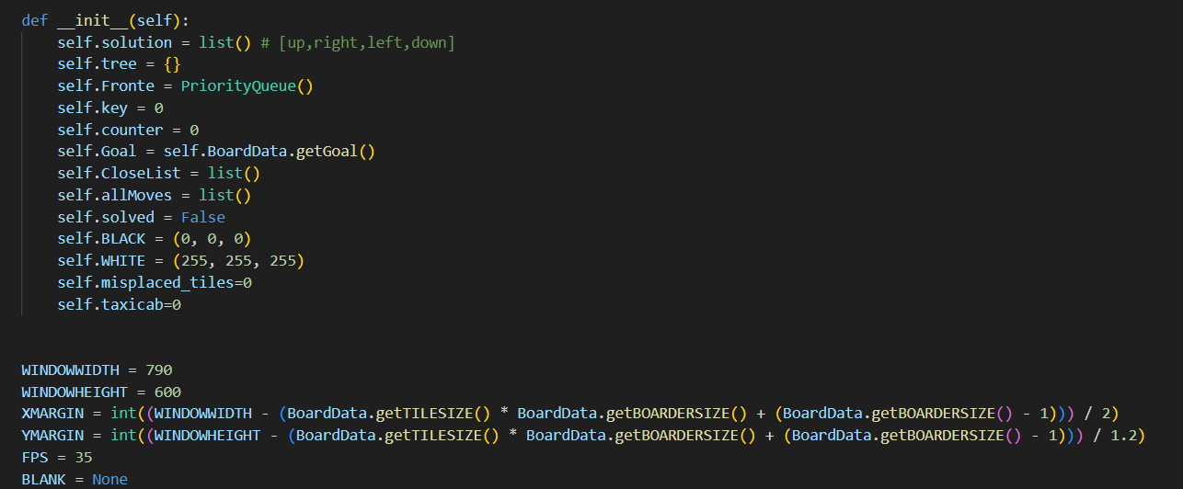
GUI code
__init__() method initializes various attributes required for managing the game, such as the solution path, tree structure, queues, counters, colors, and heuristic-related variables.
Constants like WINDOWWIDTH, WINDOWHEIGHT, XMARGIN, YMARGIN, and FPS determine the window size, margins, and frames per second for the game's display.

Slide 27
GUI code
main() method initializes the Pygame window and sets up the graphical interface, including the display caption, fonts, option buttons, and the initial puzzle board.
makeText() method creates text surfaces used for buttons, messages, and various UI elements on the game screen.
checkForQuit() method checks for quit events like clicking the 'X' button or pressing 'Escape' to exit the game.
getSpotClicked() method identifies the coordinates of the clicked tile on the board or the buttons clicked.
drawBoard() method renders the game board, tiles, buttons, and messages on the screen.
slideAnimation() method handles the animation when a tile moves.
generateNewPuzzle() method creates a new puzzle configuration by making random moves and animates the process.

Slide 28
GUI code
applysolution() method applies the solution moves to the board and animates the solved puzzle.
resetAnimation() method resets the board after solving the puzzle, animating the process.
BestFirstSearch() method implements the Best-First Search algorithm to find the solution path.
children_of_board() method generates children boards based on valid moves.
isValidMove() method checks the validity of a move on the board.

Slide 29
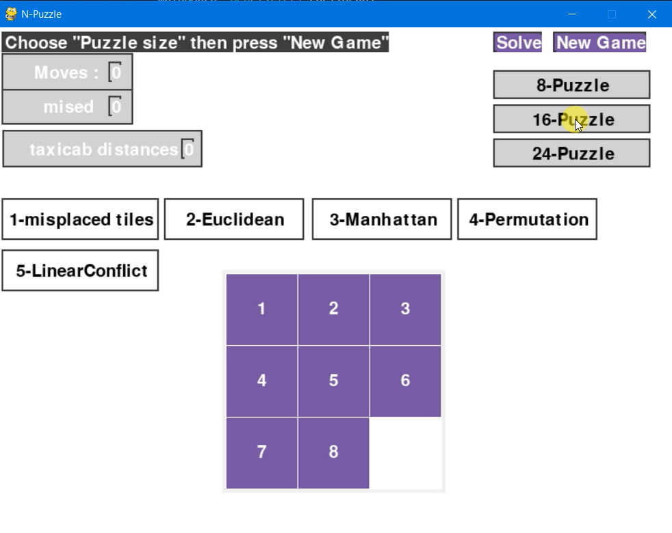
GUI Workflow
The game initializes with a puzzle board(8-puzzle as default) and UI elements.
User interactions include selecting puzzle size, press new games and playing the game .
If user want the puzzle to be solved , choosing heuristics, press solve the puzzle
Puzzle movements/animations are handled when the user slides the tiles.
Best-First Search with various heuristics is used to find the solution path.
The game continuously updates and redraws the screen based on user inputs and game state , once user press new game the gui updats the missed tiles and its distance

Slide 30


